Slide 1
Auditing LLM Trading
LLM Trading Audit • Quantitative research presentation
Maksud Bhaldar
Bridging Theory and Market Reality with Ground Truth Tables
Research-oriented project presentation
Benchmarking • Risk • Calibration • Explainability • Trust
Research presentation • September 2026

Slide 2
Research Problem
Research motivation
LLMs can generate plausible trading recommendations, but linguistic quality is not financial validity.
Traditional ML metrics such as accuracy and F1 do not capture profitability, drawdown, risk or reasoning quality.
Core research question: Can the trustworthiness of an LLM trading decision be measured systematically?
The project evaluates every recommendation against realized market outcomes and multiple audit dimensions.

Slide 3
Research Objectives
Objectives
Evaluate BUY / SELL / HOLD recommendations against future market outcomes.
Compare LLMs with conventional ML and deep-learning baselines.
Measure calibration and overconfidence using ECE, Brier score and reliability analysis.
Detect unsupported or hallucinated financial reasoning.
Validate reasoning against financial concepts such as CAPM, momentum, mean reversion and volatility.
Produce a measurable trust score for each recommendation.

Slide 4
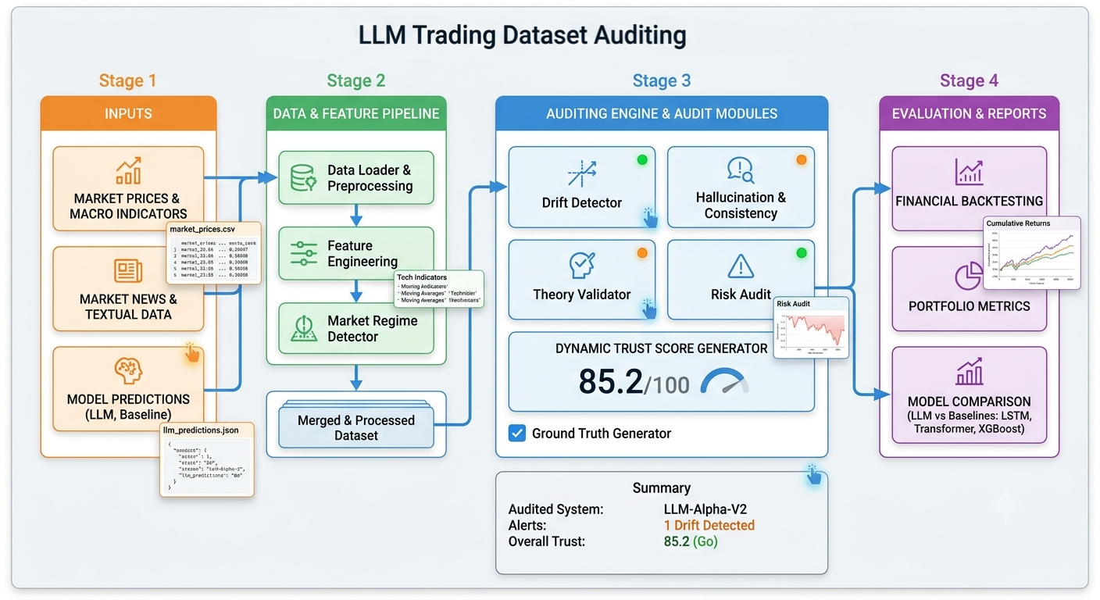
End-to-End Architecture
System architecture

Slide 5
Ground Truth (GT) Table
GT methodology
Each prediction becomes an auditable research record.
Key fields: Prediction ID, date, ticker, recommendation and model confidence.
Realized outcomes: 1D, 5D and 20D returns.
Risk/performance: maximum drawdown, Sharpe and Sortino.
Context: market regime and final TrustScore.
This creates a common evaluation layer for heterogeneous models.

Slide 6
Multi-Dimensional Audit Framework
Audit dimensions
Calibration audit — Is confidence aligned with actual success probability?
Hallucination audit — Are financial claims supported by evidence?
Theory audit — Does reasoning agree with established financial relationships?
Risk audit — Does the recommendation violate exposure, drawdown or tail-risk constraints?
Explainability — Which inputs/features materially influence the decision?
Outcome audit — Did the recommendation translate into favorable risk-adjusted performance?

Slide 7
Evaluation & Quantitative Metrics
Metrics
Performance: realized return, hit rate, Sharpe, Sortino and maximum drawdown.
Risk: Value at Risk (VaR), Conditional VaR, position-size risk and exposure risk.
Calibration: Expected Calibration Error (ECE), Brier score and reliability diagrams.
Explainability: SHAP and LIME analyses for model-driven decisions.
Market context: compare behavior across Bull, Bear and Crash regimes.
Research principle: evaluate performance after costs and under time-series-safe validation when extending the benchmark.

Slide 8
Experimental Design & Research Extensions
Research design
Baseline experiment: compare LLM recommendations with ML/DL models under the same market observations.
A stronger study should use walk-forward evaluation and strict temporal leakage controls.
Add transaction costs, slippage and turnover to distinguish paper alpha from implementable alpha.
Extend from trade-level auditing to portfolio-level risk and correlated exposures.
Add adversarial / red-team agents to challenge investment theses.
Add counterfactual tests to measure decision sensitivity to changes in evidence and assumptions.

Slide 9
Expected Contribution & Limitations
Scientific interpretation
Contribution: a structured framework for auditing LLM trading decisions rather than judging them only by prediction accuracy.
Contribution: unified GT records connect model reasoning to realized financial outcomes.
Contribution: combines AI evaluation with financial risk, calibration and explainability.
Current limitation: the repository uses synthetic datasets, so results should not be interpreted as evidence of live-market profitability.
Important next step: independent reproduction with frozen protocols, real historical data and robust baselines.

Slide 10
Models, Mathematics & Statistics
LLM Trading Audit — Quantitative Model & Audit Methodology
How the project converts predictions into measurable financial evidence
Models • Equations • Statistical metrics • Risk • Calibration

Slide 11
Model Stack & Research Roles
LLM Trading Audit • Quantitative research presentation
LLM Trader — processes market context, news/text and produces BUY / SELL / HOLD + confidence.
XGBoost — gradient-boosted decision-tree baseline for structured financial features.
LSTM — recurrent sequence model for temporal dependencies in prices/features.
Transformer — self-attention model for time-series sequence modeling.
The repository explicitly organizes these model families under models/llm, models/xgboost, models/lstm and models/transformer.
The research question is not “which model is best?” but “which model is reliable across performance, risk, calibration and explainability?”

Slide 12
Financial Data → Mathematical Features
LLM Trading Audit • Quantitative research presentation
Simple return:
Log return:
Rolling mean:
Rolling volatility:
Momentum:
The pipeline also uses volume, technical indicators, macro variables and sentiment-related features.

Slide 13
XGBoost — Gradient Boosting Mathematics
LLM Trading Audit • Quantitative research presentation
Base learner: a decision tree fk(x). The ensemble prediction is additive:
At iteration t, the objective combines fit and regularization:
Typical tree regularization penalizes complexity:
Why useful here: strong tabular baseline, nonlinear interactions, fast inference and comparatively reproducible behavior.
Audit role: provides a structured-data benchmark against which LLM claims can be contextualized.

Slide 14
LSTM & Transformer — Sequence Mathematics
LLM Trading Audit • Quantitative research presentation
LSTM maintains a memory state through gates:
Transformer self-attention:
LSTM emphasizes recurrent memory; Transformer attention learns relationships across positions in the input sequence.
Both require strict temporal validation because randomly shuffling financial observations can create look-ahead leakage.

Slide 15
Prediction → Ground Truth Mathematics
LLM Trading Audit • Quantitative research presentation
For each prediction at time t, the auditor observes future realized returns:
where h ∈ {1,5,20} days
Directional correctness can be defined as:
Correct = 1[sign(predicted direction) = sign(R_{t,h})]
For a trading strategy, cumulative wealth is:
This creates the bridge between an AI statement made at t and the market outcome that became observable only after t.

Slide 16
Performance & Risk Statistics
LLM Trading Audit • Quantitative research presentation
Annualized Sharpe:
Sortino replaces total volatility with downside deviation:
Maximum drawdown:
Value at Risk at confidence α:
Conditional VaR / Expected Shortfall:
Also evaluate cumulative/annualized return, volatility, hit rate, profit factor and turnover.

Slide 17
Calibration, Drift & Statistical Validity
LLM Trading Audit • Quantitative research presentation
If the model reports confidence pi, calibration asks whether outcomes occur with approximately probability pi.
Brier score:
Expected Calibration Error:
Reliability diagram: compare predicted confidence with empirical frequency.
Drift can be studied by comparing reference and current feature/prediction distributions.
Research-grade extension: walk-forward validation, confidence intervals, bootstrap analysis and statistical significance tests.
Important: a high backtest return is not sufficient evidence of skill without leakage controls and multiple-testing awareness.

Slide 18
Explainability + Trust Score Mathematics
LLM Trading Audit • Quantitative research presentation
SHAP decomposes a prediction into feature contributions:
LIME approximates a local model around one observation using an interpretable surrogate.
A conceptual Trust Score combines independent audit dimensions:
Weights should be configurable and empirically validated; T is a model-risk indicator, not a guarantee of profitability.
The project’s audit engine includes calibration, hallucination, theory, risk, consistency, drift and trust-score components.

Slide 19
Statistical Research Interpretation
LLM Trading Audit • Quantitative research presentation
Model comparison should be multi-objective:
Economic value + risk-adjusted return + calibration + evidence quality + robustness + operational reliability.
A 92% confident BUY that wins 55% of the time is statistically and economically different from a genuinely calibrated 92% prediction.
A strategy with high return but extreme drawdown may be inferior on a risk-adjusted basis.
A model that performs only in one regime may have weak robustness despite strong aggregate results.
The strongest next step is a reproducible walk-forward experiment using point-in-time real data, transaction costs, slippage and independent statistical validation.
Bottom line: the project evaluates whether an AI decision is not only correct, but quantitatively defensible and trustworthy.

Slide 20
Conclusion
Takeaway
The central idea is simple: an LLM should not be trusted merely because its explanation sounds convincing.
A credible financial AI system needs measurable evidence, calibrated confidence, risk controls and reproducible evaluation.
This project provides a strong foundation for an autonomous quant-research audit platform.
Future direction: Research Agent → Evidence Graph → Risk Engine → Execution Simulator → Audit Engine → Human-gated decision.
Repository: github.com/macbhaldar/llm-trading-audit

